Slide 1


Slide 2
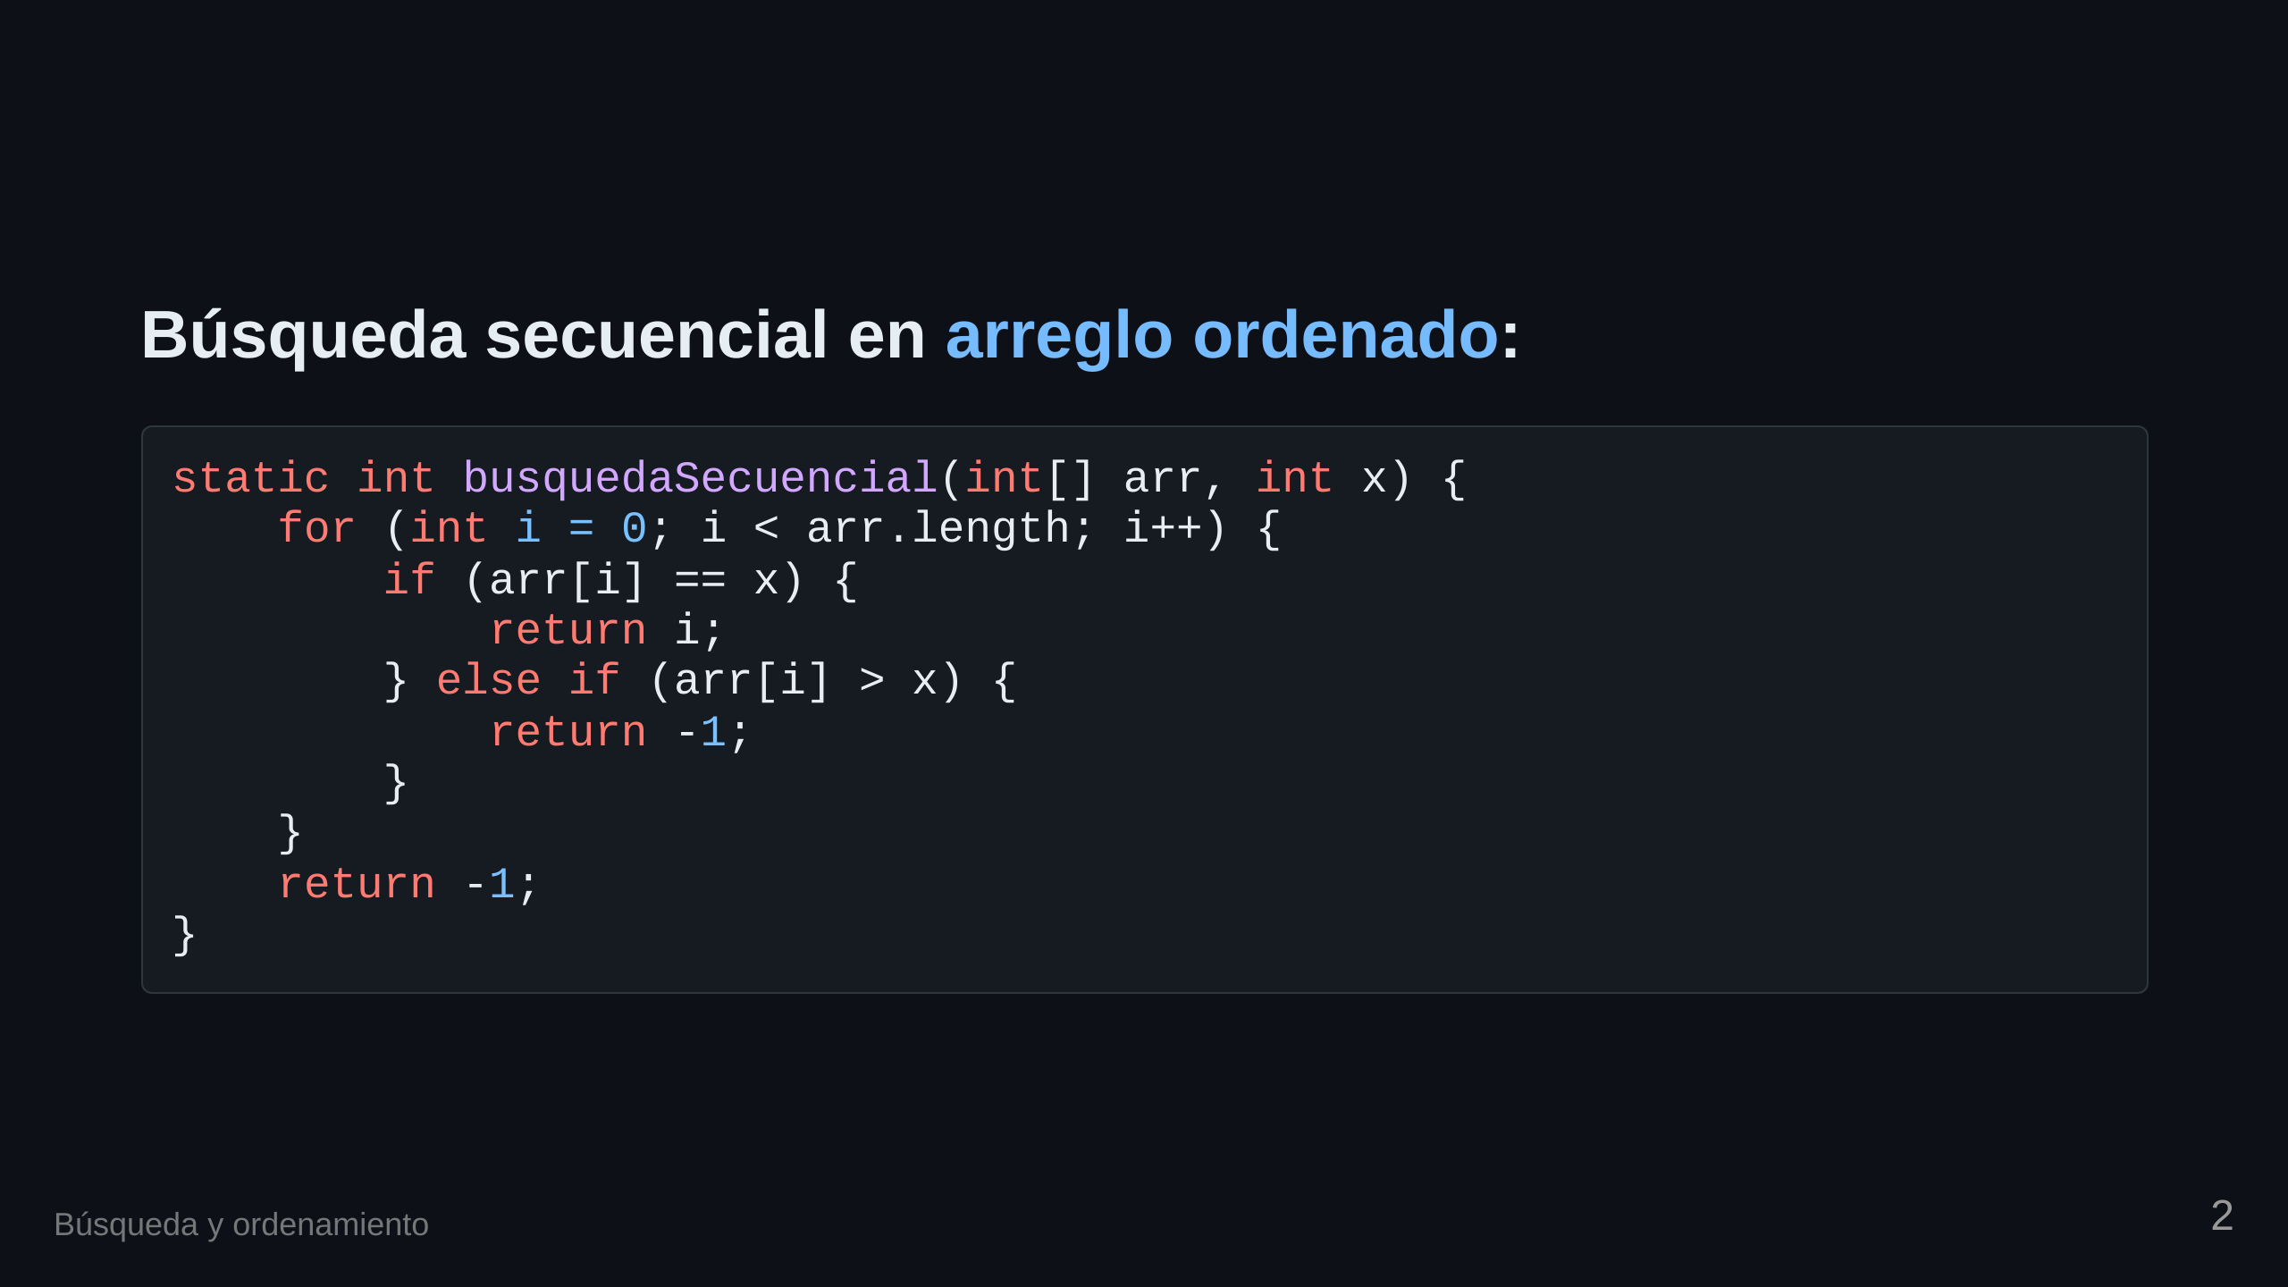

Slide 3
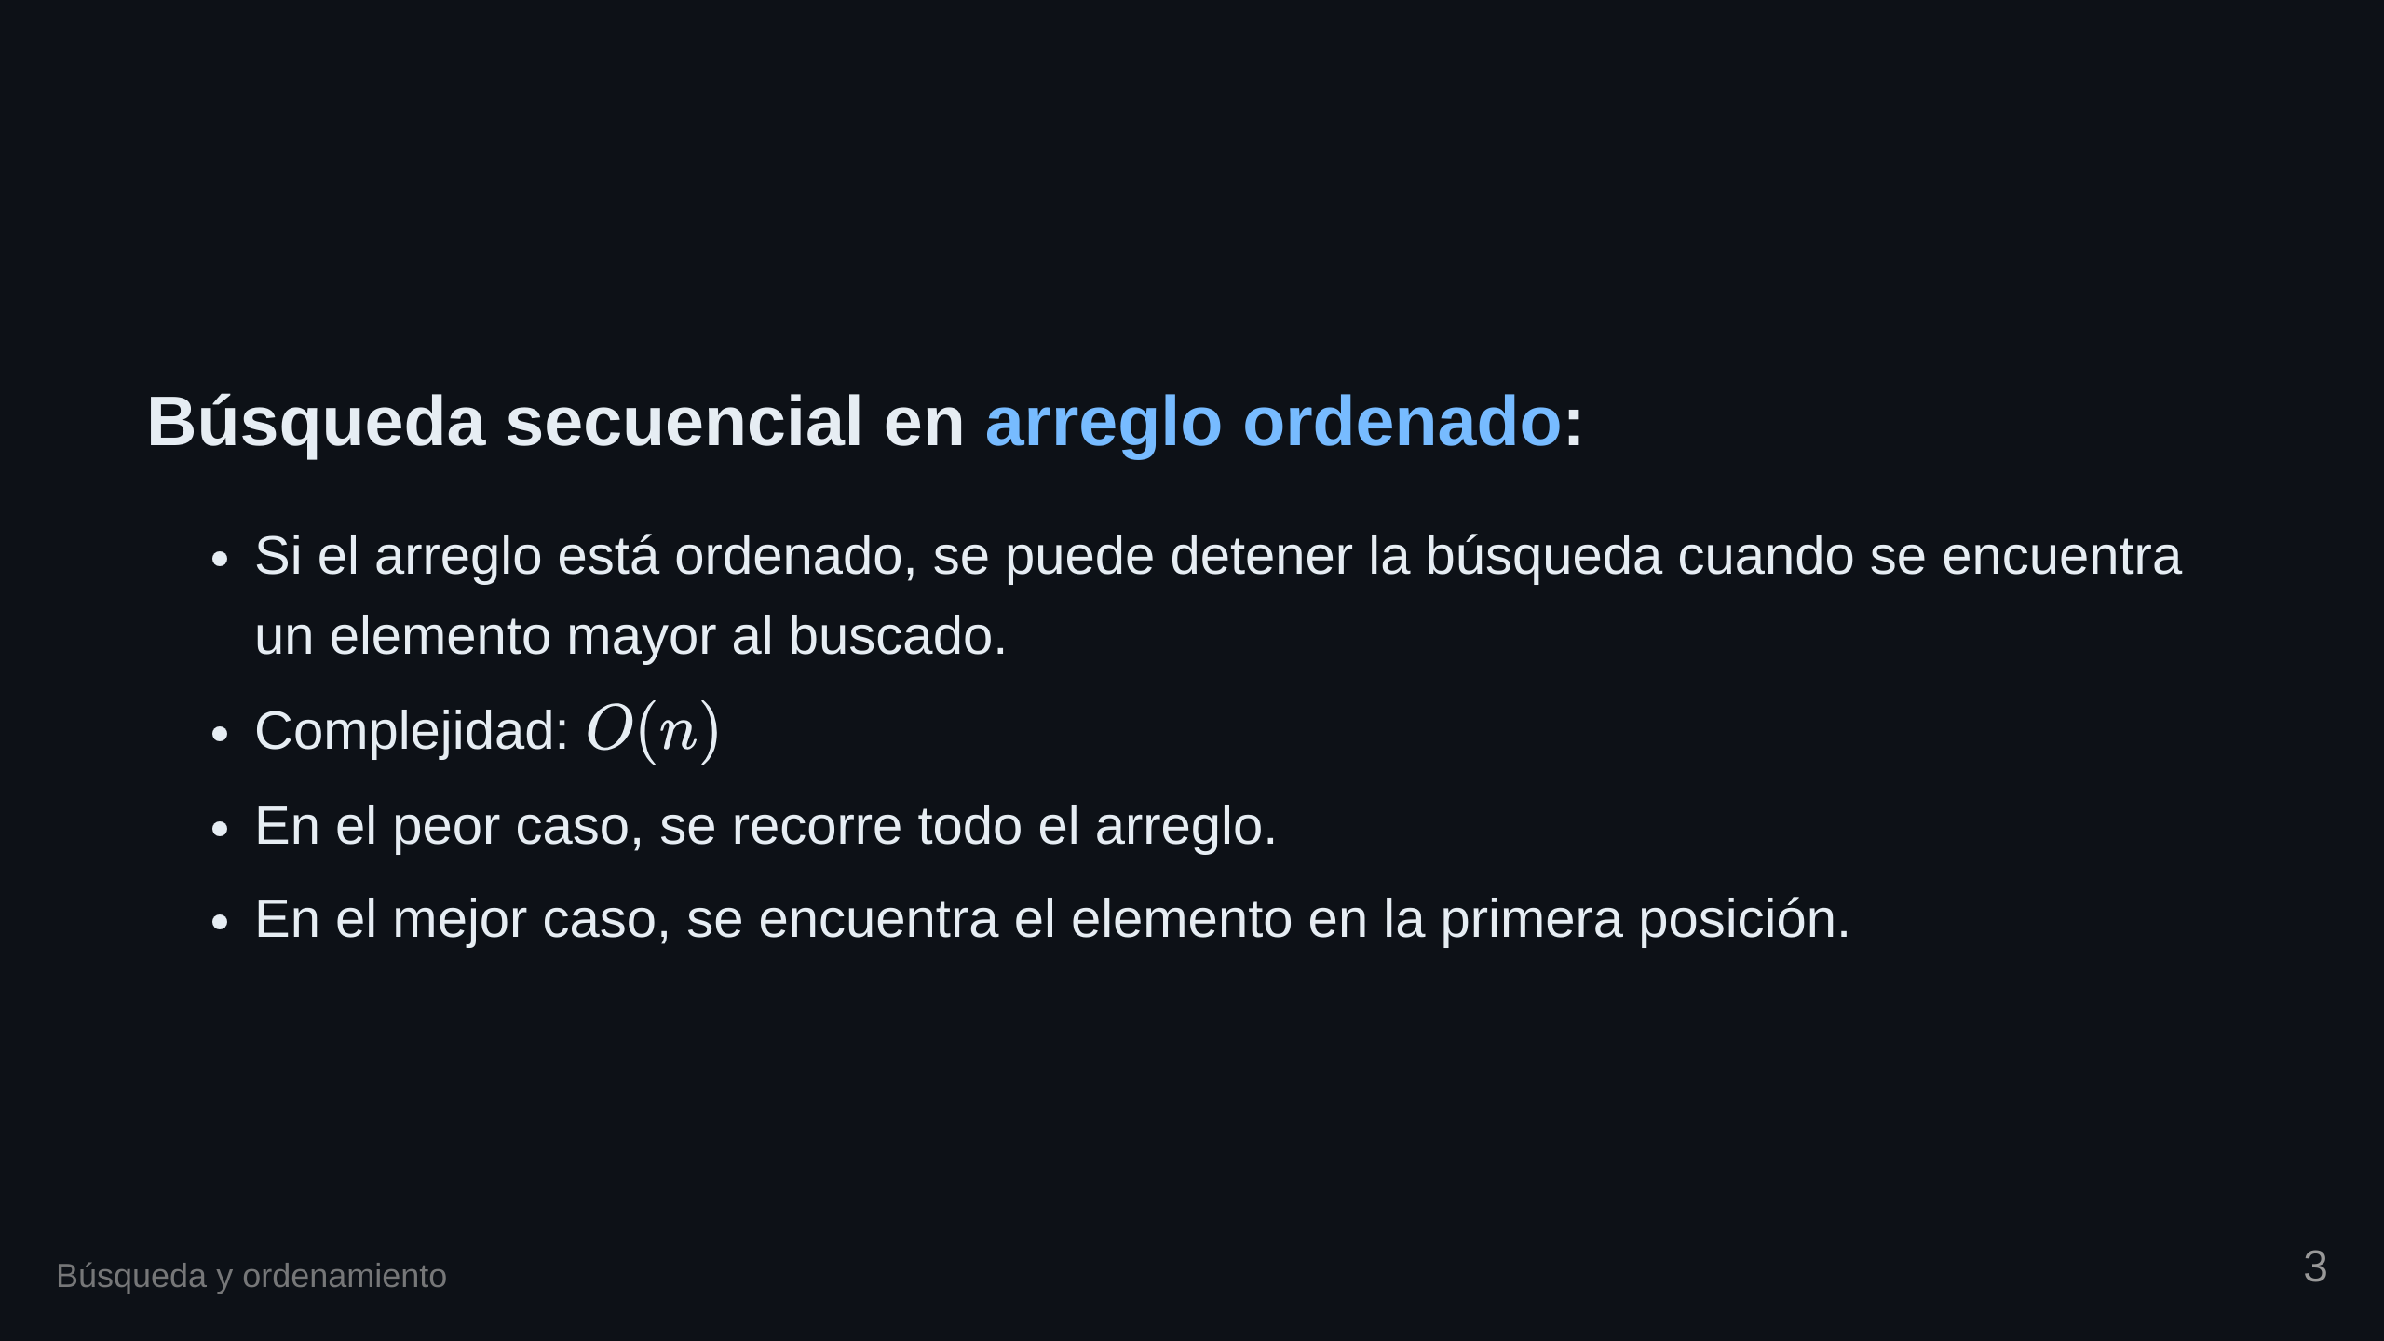

Slide 4
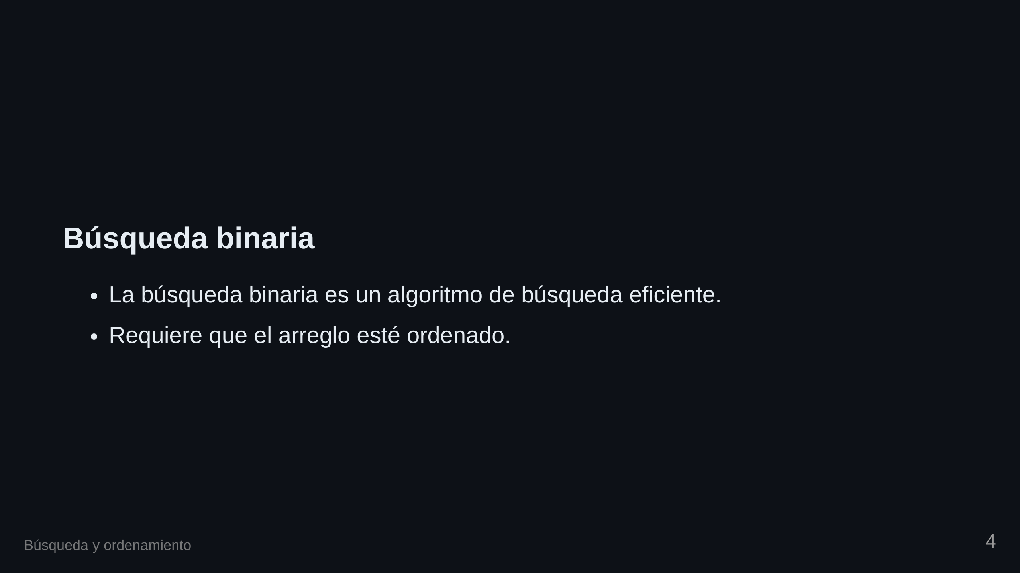

Slide 5
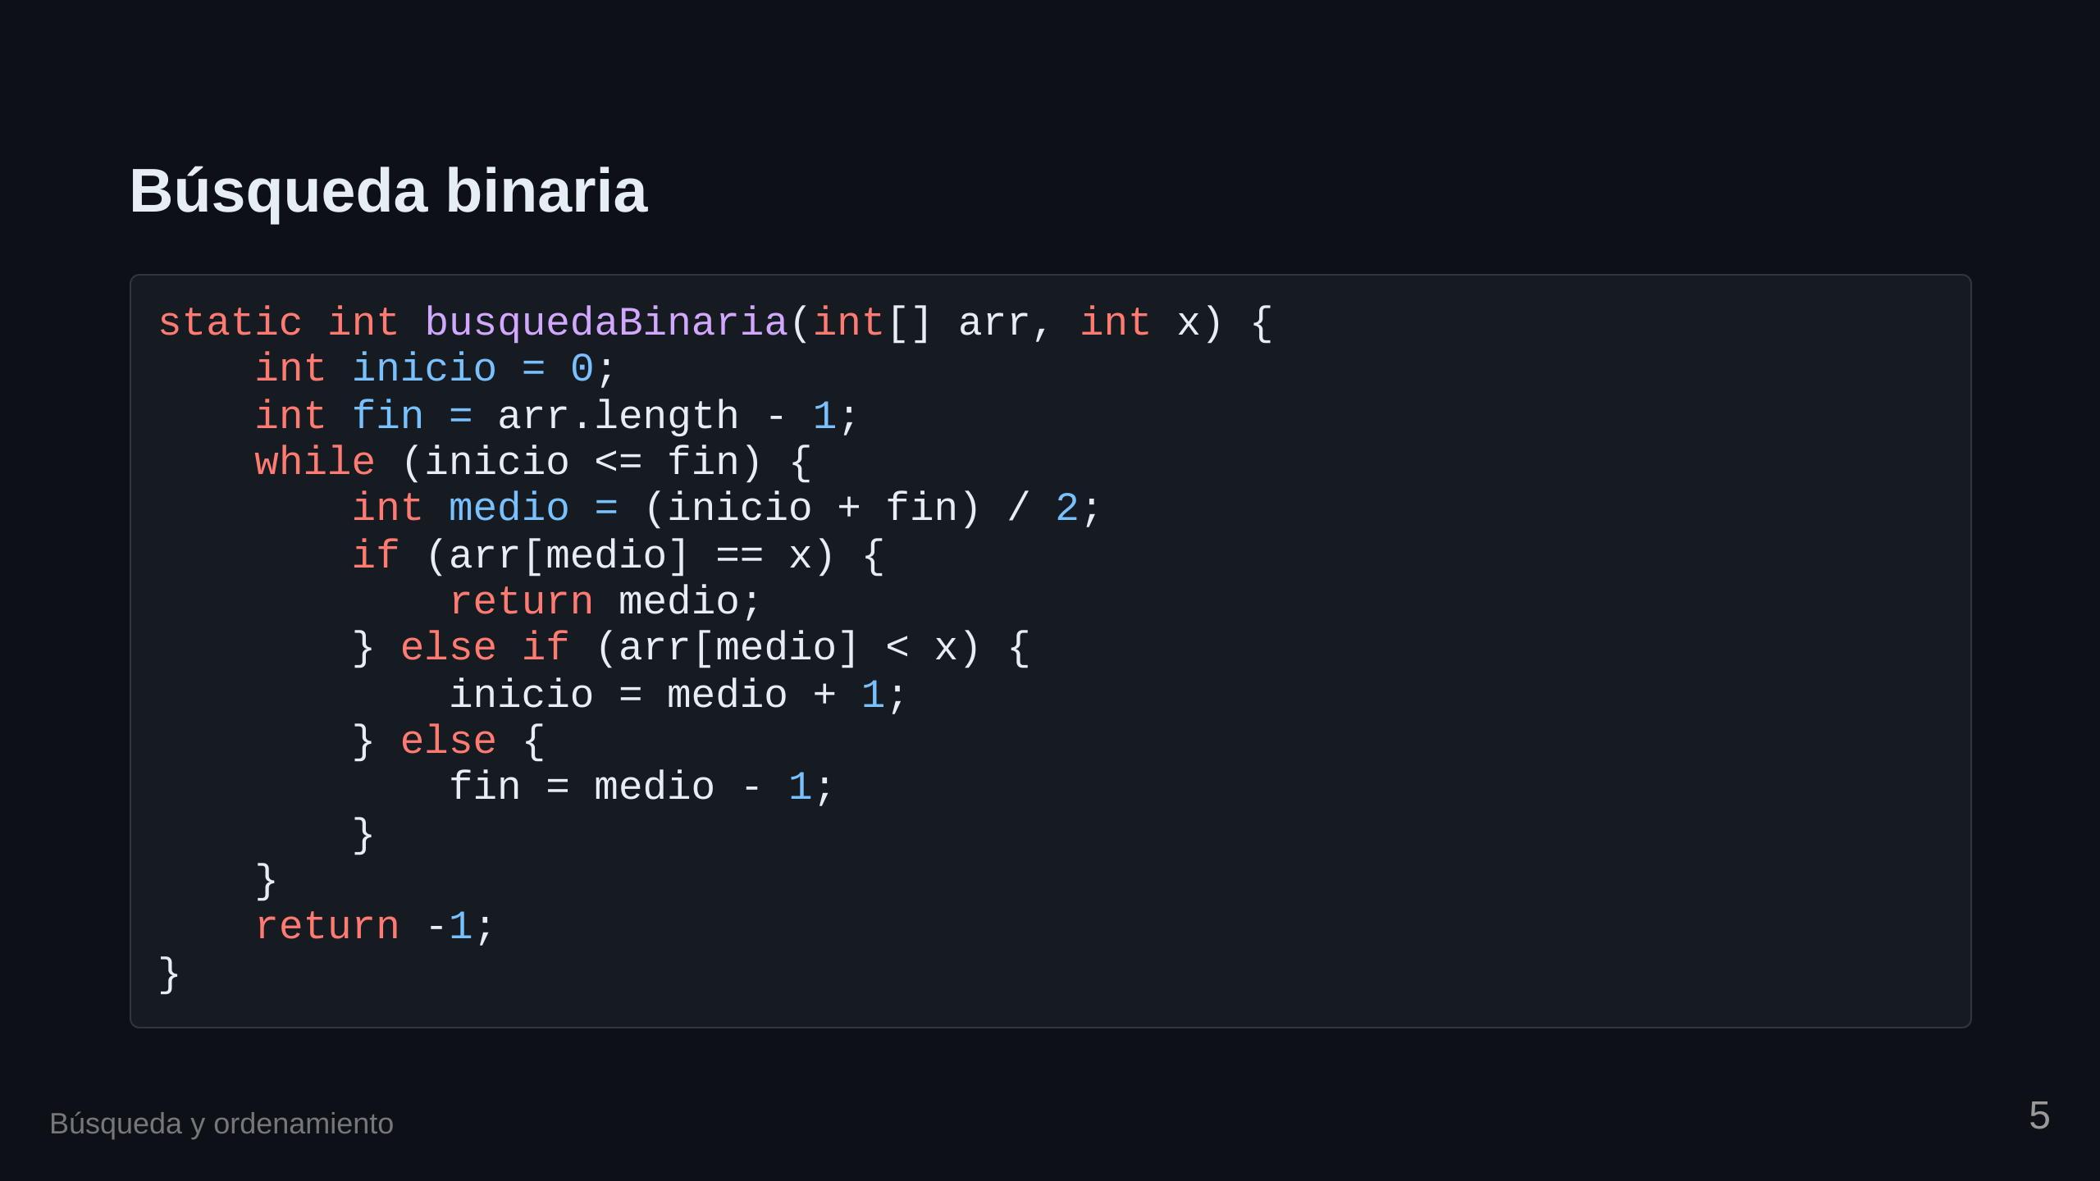

Slide 6
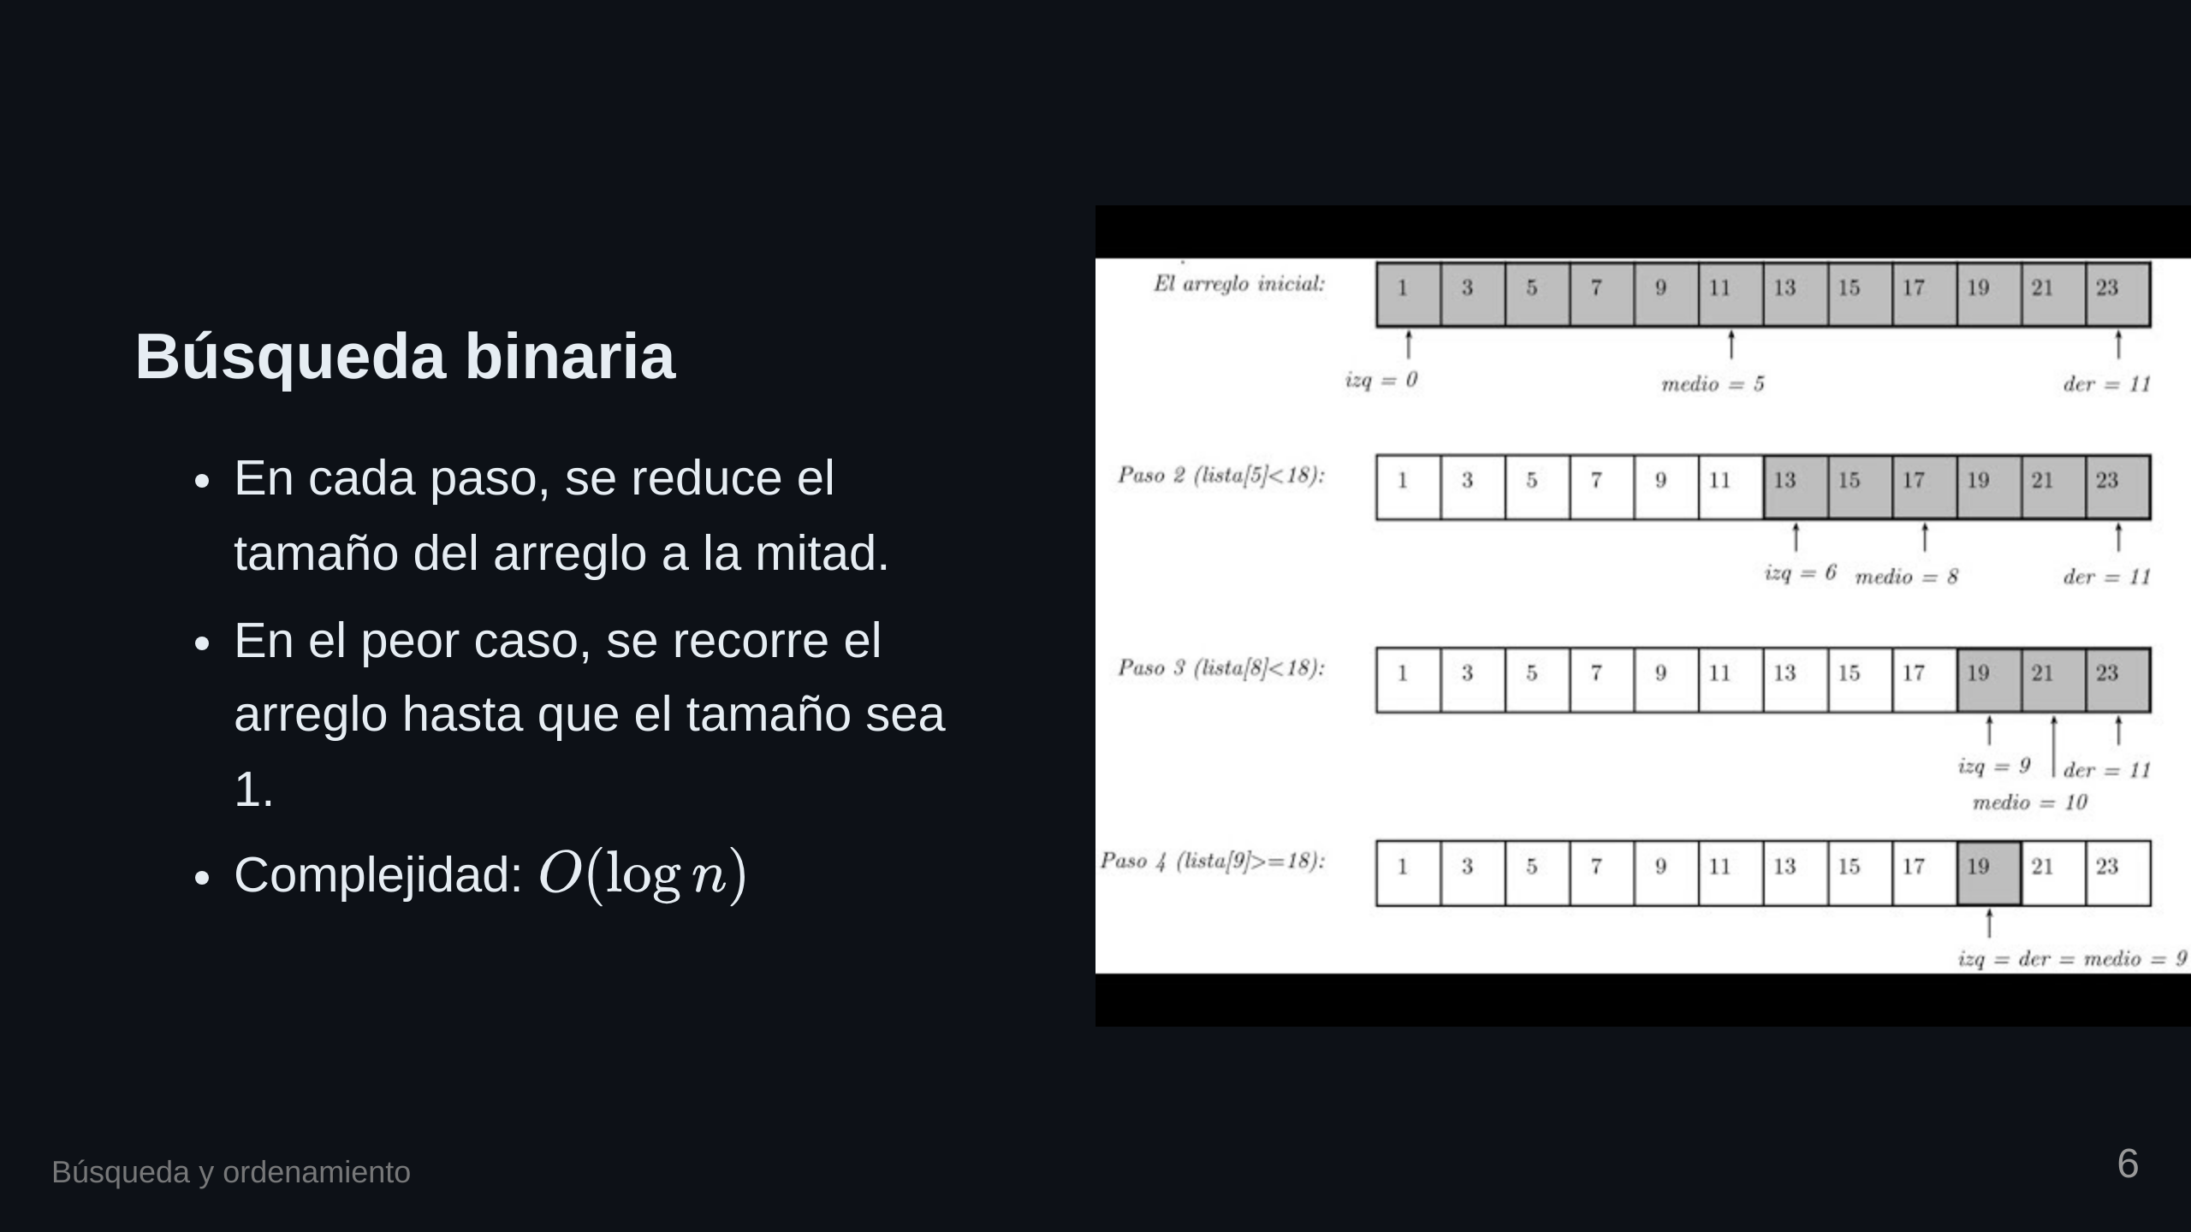

Slide 7


Slide 8
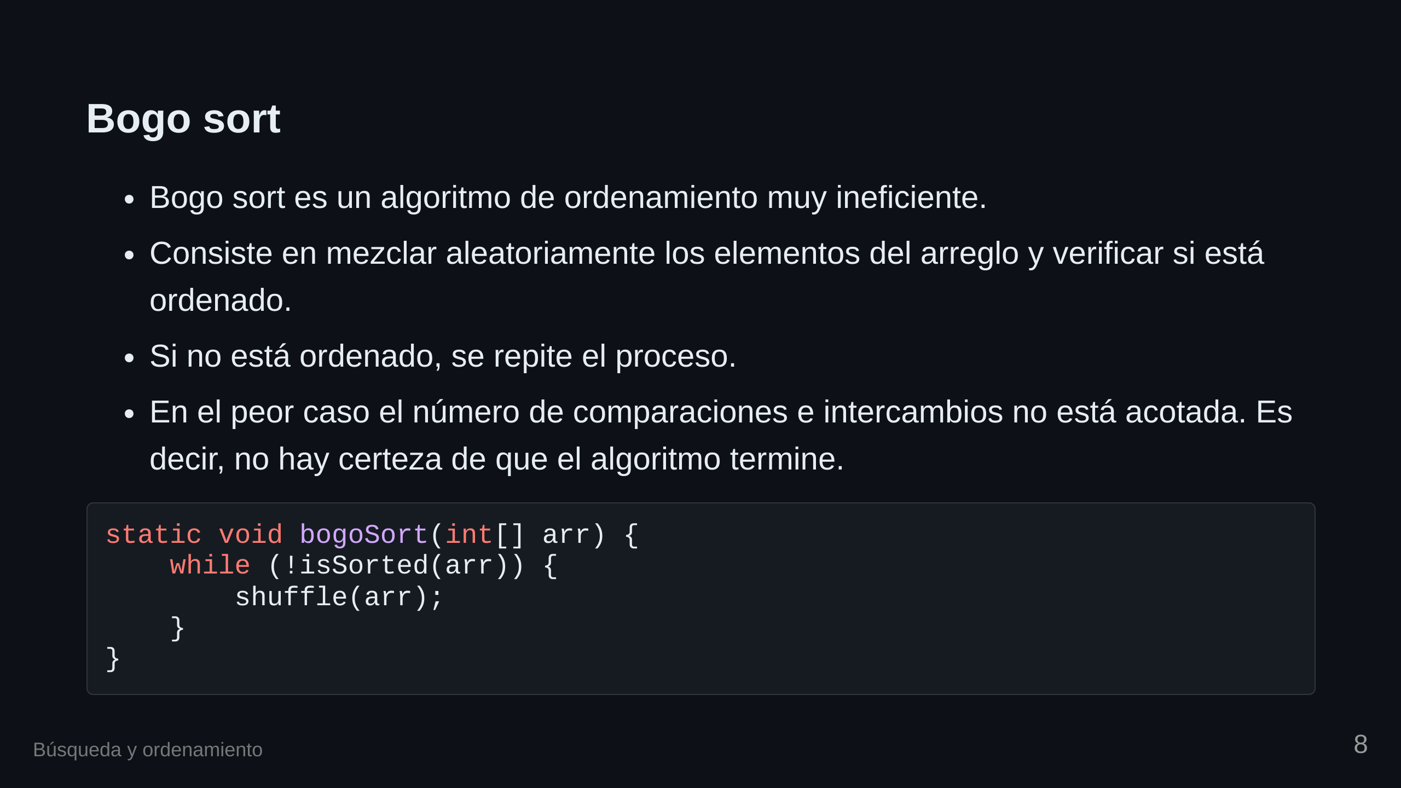

Slide 9
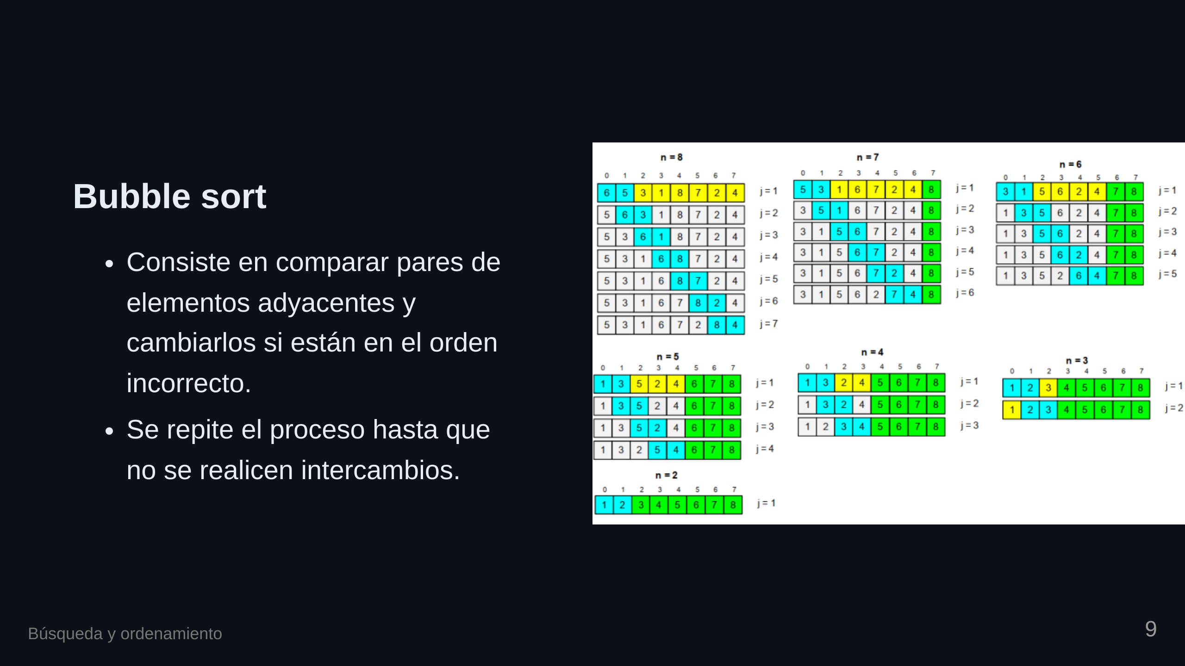

Slide 10

Notes:
transition: fade

Slide 11


Slide 12


Slide 13

Notes:
transition: slide

Slide 14
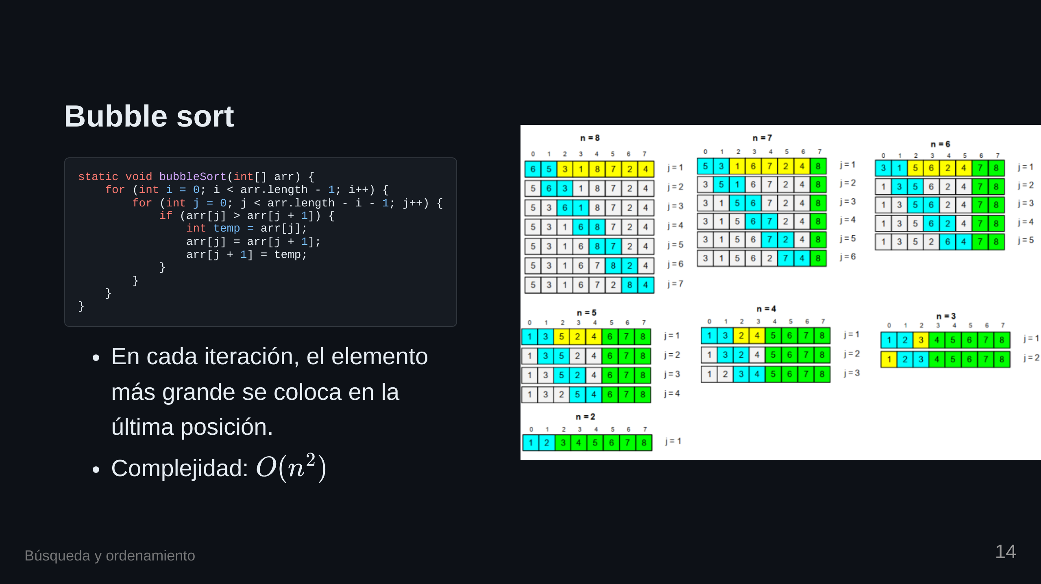

Slide 15
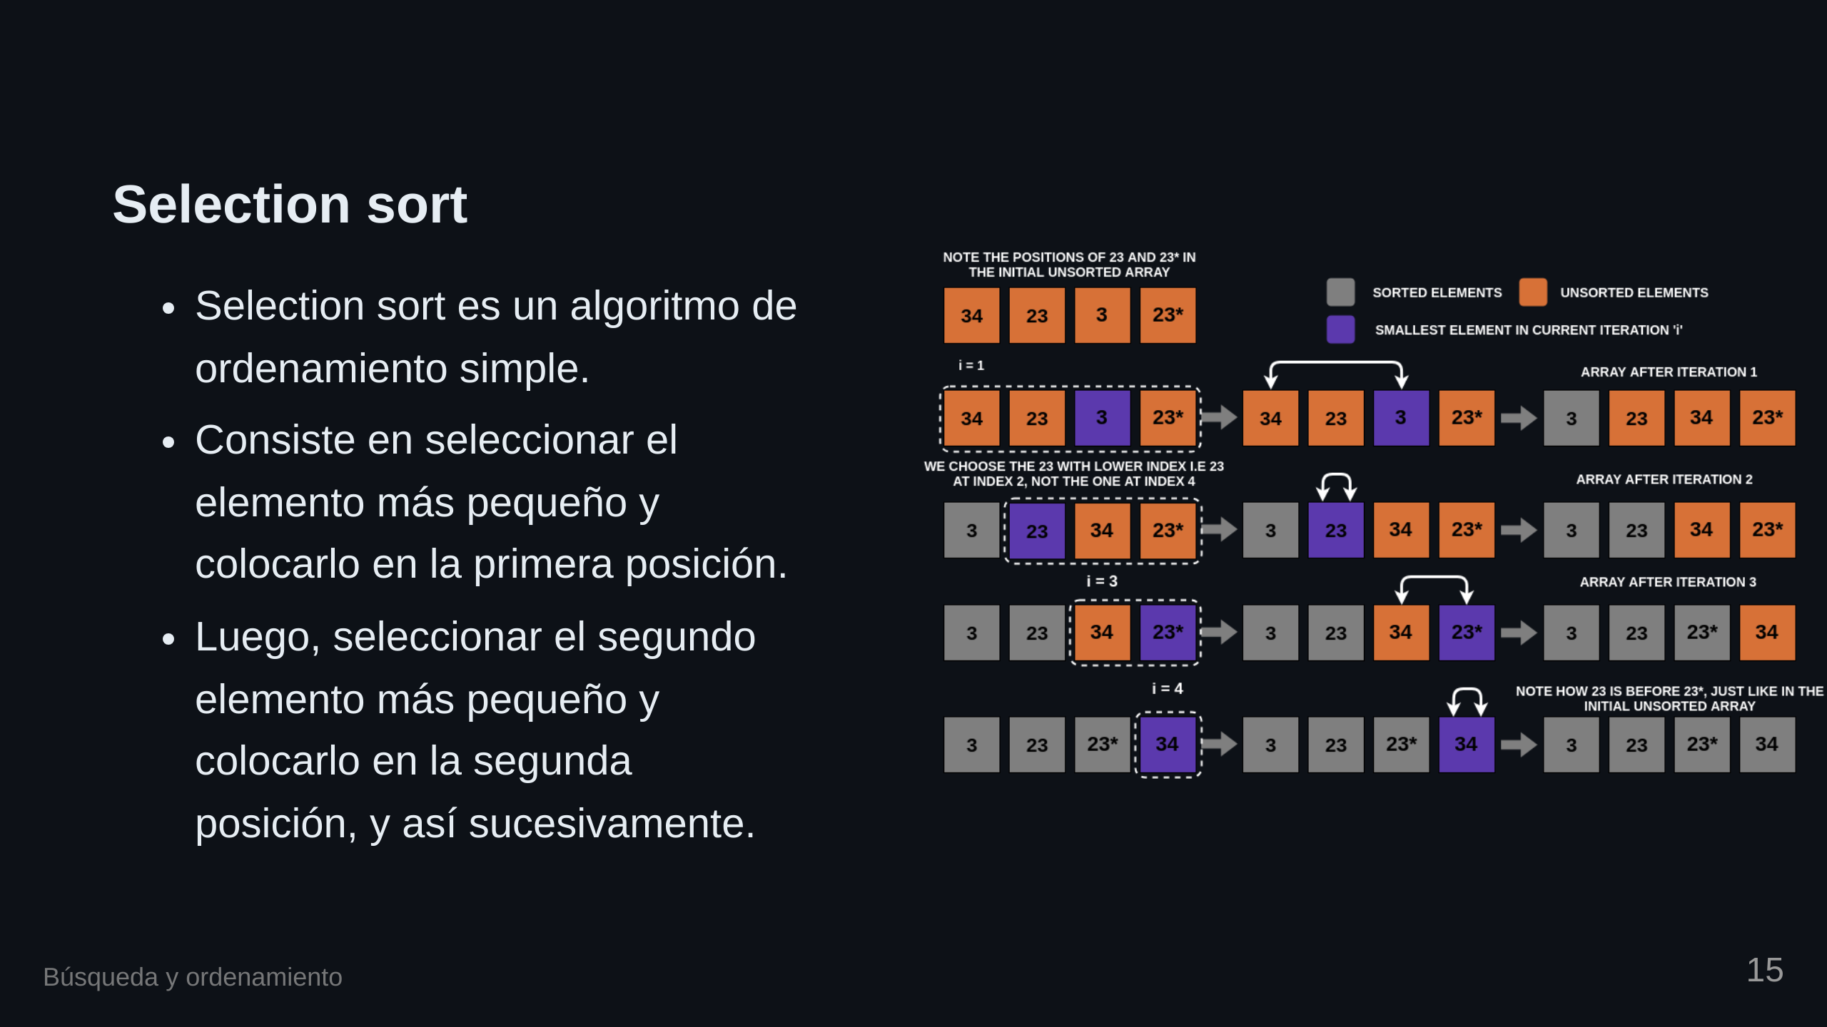

Slide 16

Notes:
transition: fade

Slide 17


Slide 18


Slide 19

Notes:
transition: slide

Slide 20
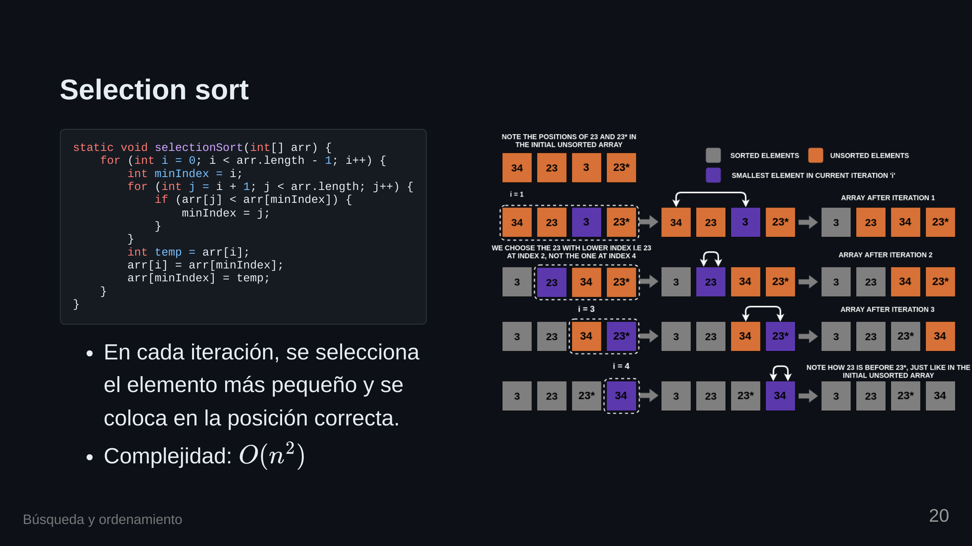

Slide 21
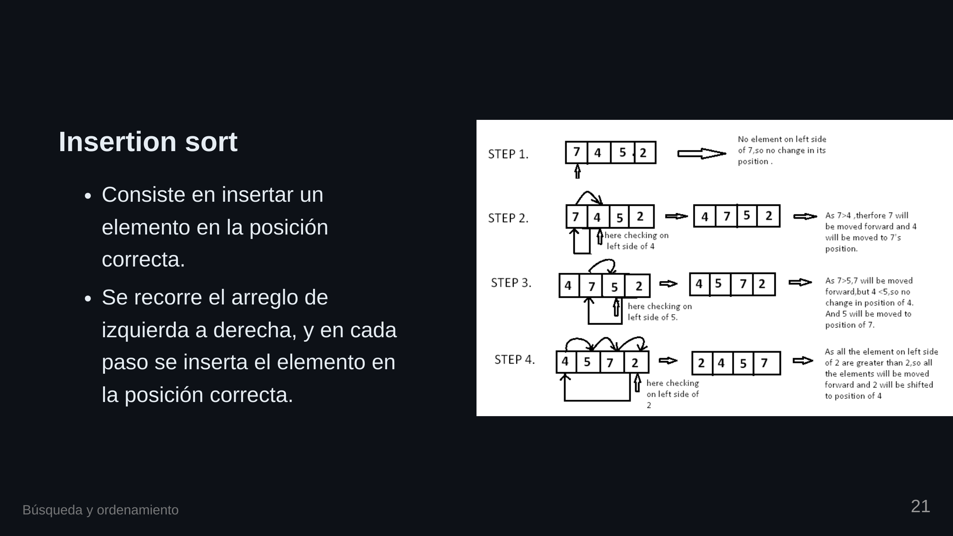

Slide 22

Notes:
transition: fade

Slide 23


Slide 24

Notes:
transition: slide

Slide 25
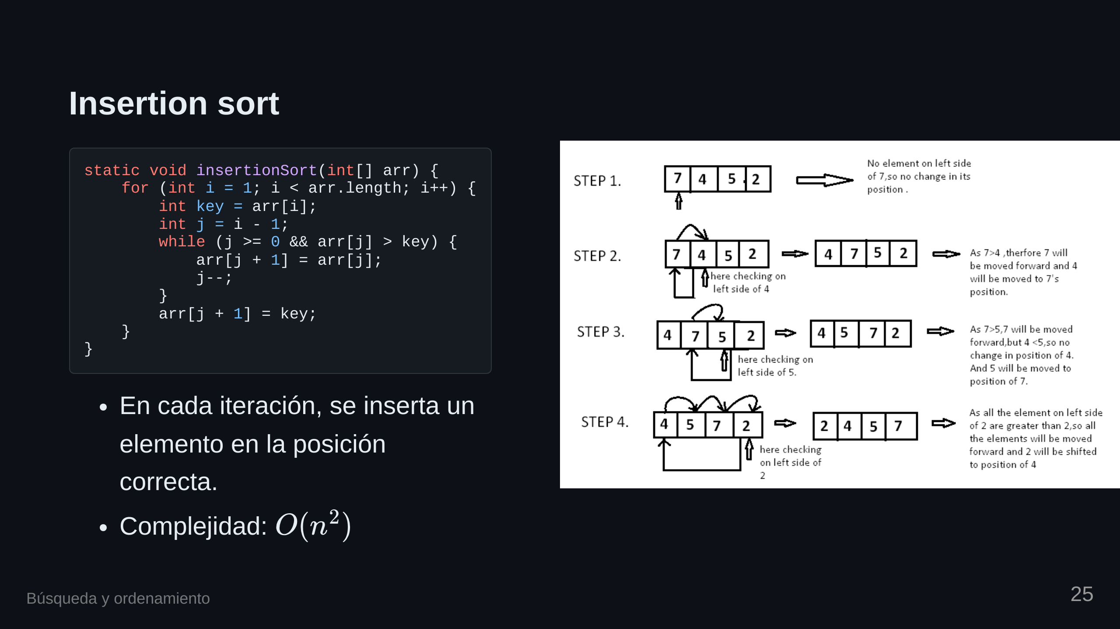

Slide 26


Slide 27
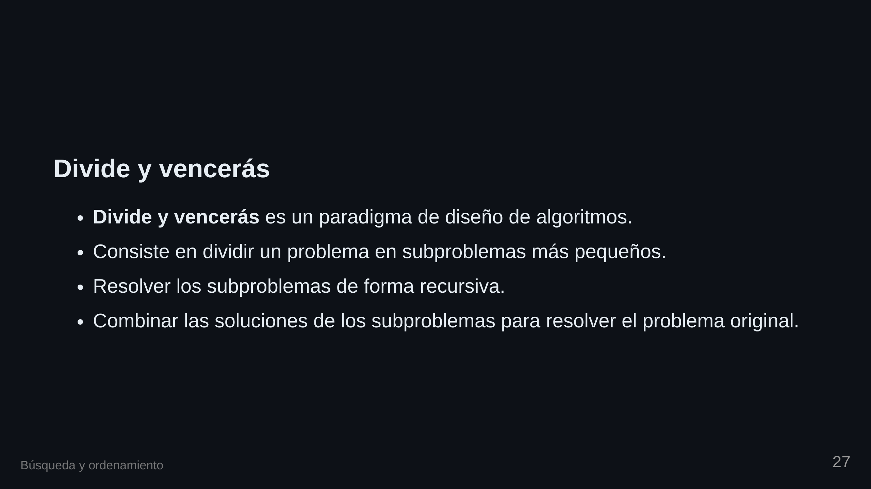

Slide 28
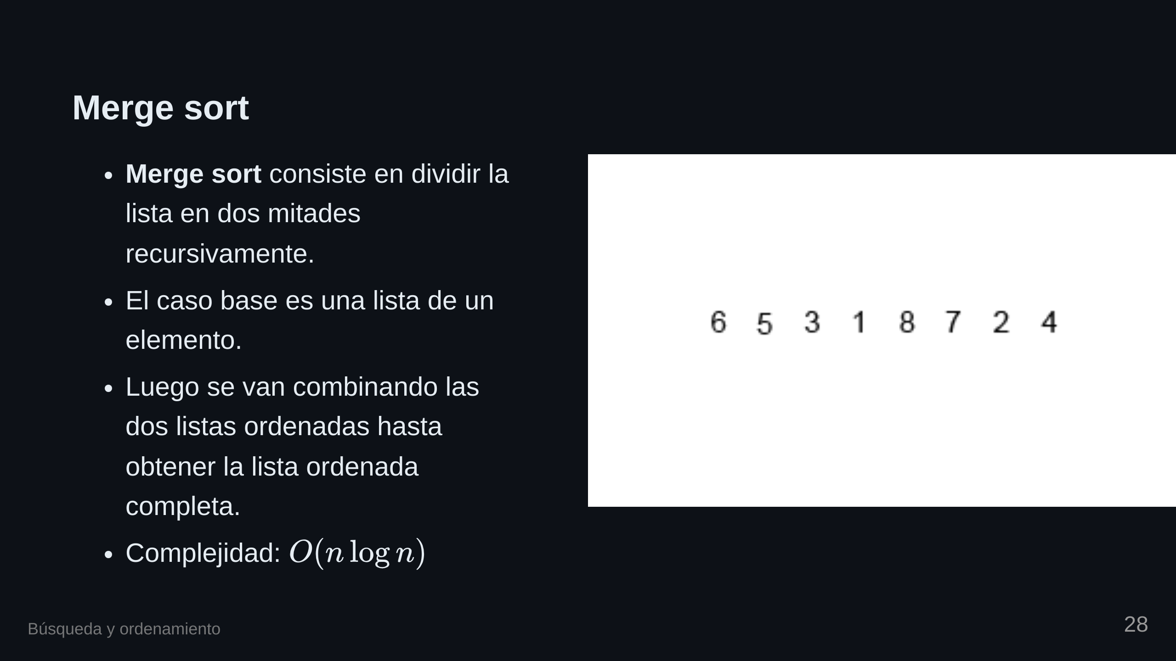

Slide 29
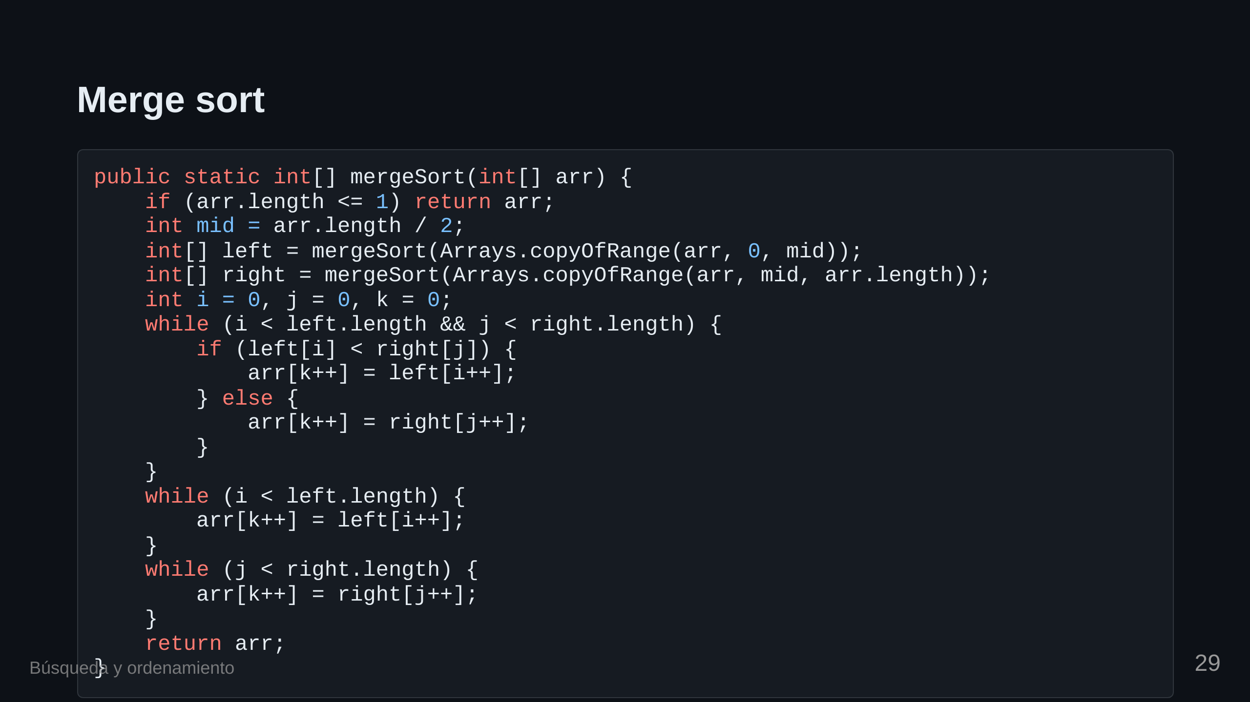

Slide 30

Notes:
transition: fade

Slide 31

Notes:
Dividiendo la lista

Slide 32

Notes:
Dividiendo más

Slide 33

Notes:
Comenzando a fusionar

Slide 34

Notes:
Fusion final transition: slide ![bg h:500px](./images/13/merge.png)

